Slide 1
Projektiliiketoiminnan tutkimustuloksilla onnistumiseen Karlos Artto
Aalto-yliopisto
PSK:n kevätseminaari 2013
Pörssitalo, Fabianinkatu 14, Helsinki
18.4.2013
Project Business research group at Aalto University, Finland
http://pbgroup.aalto.fi/en/

Slide 2
Projektiliiketoiminnan tutkimustuloksilla onnistumiseen
Menestys (kriteerit)
Aika (pitkä aikajänne, systeemin elinkaari)
Kenen näkökulma?
Projekti usean yrityksen verkostona

Slide 3
Cost estimate overruns in road and rail infrastructure projects
Type of project
No. of cases (N)
Average cost overrun %
Standard deviation %
Rail
58
44,7
38,4
Bridges & tunnels
33
33,8
62,4
Road
167
20,4
29,9
Flyvbjerg 2006

Slide 4
Channel Tunnel & Copenhagen Metro Ex post evaluation
Channel Tunnel
Actual costs = 2 x estimate
Actual benefits = ½ x forecast
Actual NPV = $ -17,8 billion
Actual IRR = -14,45 %
Conclusion: ”The Bristish economy would have been better off had the tunnel never been constructed” (R. Anguera, Transportation Research A40, 2006)
Copenhagen Metro
Actual costs = 3 x estimate
Actual patronage = 0,6 x forecast
Flyvbjerg 2006

Slide 5
Cost risks & benefit risks
Costs:
9 out of 10 projects have cost overruns
Based on data from 20 nations on 5 continents
Overrun is constant for the past 70 years -> estimates have not improved
Benefits:
9 out of 10 rail projects have overestimated traffic
Average rail passenger shortfall is 51,4%
Traffic forecasts have not improved for 30 years
Flyvbjerg 2006

Slide 6
Applicable capital expenditure optimism bias uplifts for 50% and 80% percentiles, constant prices
Category
Types of projects
Applicable optimism bias uplifts
50 % percentile
80 % percentile
Roads
Motorway
Trunk roads
Local roads
Bicycle facilities
Pedestrian facilities
Park and ride
Bus lane schemes
Guided buses on wheels
15 %
32 %
Rail
Metro
Light rail
Guided buses on tracks
Conventional rail
High speed rail
40 %
57 %
Fixed links
Bridges
Tunnels
23 %
55 %
Building projects
Stations
Terminal buildings
4 – 51 % *
IT projects
IT system development
10 – 200 % *
Std civil eng.
3 - 44 % *
Non-std civ. eng.
6 – 66 % *
* based on Mott MacDonald (2002)
Flyvbjerg 2006

Slide 7
A firm’s view on project success
Cooke-Davies, 2004
Level of hierarchy required to give commitment
Consistent project success –
Were right projects done right, time after time?
Project success –
Was the right project done?
Project Management success –
Was the project done right?
Time elapsed before measurement is possible

Slide 8
Project success criteria in time
Societal effects
Samset, 2003
Uncertainty
Needs satisfaction
Relevance
Economic effects
Impact
Goal achievement
Time
Cost
Scope
Time

Slide 9
Factors and Criteria comparison
How to achieve success?
What success is?
Factors
Criteria
LINK
Project
0
Post-project
Time

Slide 10
Specific Success Measures
Project Success
Efficiency
Impact on
Customer
Impact on
Team
Business & Direct Success
Preparing for Future
Meeting schedule
Meeting budget
Changes
Yield
Other efficiencies
Meeting requirements and specifications
Benefit to customer
Extent of use
Customer satisfaction & loyalty
Brand name recognition
Team satisfaction
Team morale
Skill development
Team member growth
Team members’ retention
No burnout
Sales
Profits
Market share
ROI, ROE
Cash flow
Service quality
Cycle-time
Organizational measures
Regulations approval
New technology
New market
New product line
New core competencies
New organizational capabilities
Adopted from: Shenhar & Dvir, 2007

Slide 11
Evaluating the effects of a project
Impact of effects
Sustainability of effects
Internal efficiency
External effectiveness
Inputs / resources
Operational objectives
Tactical objectives
Strategic objectives
Relevance of effects
Needs / Priorities
Project
Process
Source: Samset, 2003

Slide 12
Modelling effects
Outputs
Mechanisms of effect
Effects
Fever
Phone calls,
Less mail
Fever
queries
Web-based
Customer
information
Less
Dependence on
staff
Reduced
expenditures
More time for
Other tasks
Customer
satisfaction
24x7
availability
Web-based
service
information
Increased
effectiveness
Greater awareness
Better
Take-up service
Less advertising in
papers
Better market
image
One-stop information
collection
Better quality
ïnformation
Web-based
transactions
Standardization of
forms
Faster processing
modified from: OGC, 2003

Slide 13
From an individual projects towards the businesses among firms: Two interrelated layers: permanent business network and temporary project networks
Active project
No project
Active project
No project
Active project
Active project
Project
networks
of individual
projects
Business
network
(of firms or of organizations)
modified from Eloranta 2007 (= Kirsi Aaltonen, 2007)
& Artto, Eloranta, & Kujala, 2008

Slide 14
Subcontractors’ business relationships as risk sources in project networks
Client
Contractor
Competitor
Non-
business actor
Sub-
contractor
Sub-
contractor
Artto, Eloranta, Kujala 2008

Slide 15
Building market position: case Metso in Russian oil and gas markets
Ahola T., Kujala J., Aaltonen K., Laaksonen T. (2013). Constructing the market position of a project-based firm. International Journal of Project Management, 31(3):355-365.
In order to be successful project-based firms need to create
Core technologies, competences and delivery capability (functional positioning)
Relationships with key business and non-business related actors (relational positioning)
These two interrelated concepts form market position of a project-based firm.

Slide 16
Challenge for Metso Automation in 1990’s
In late 1990’s Metso Automation had very few deliveries for Oil and Gas business in Russia
It was not well known and considered as capable supplier in the market segment
Project product (=delivery of complete system to customer) had not been modified to meet specific requirements of this market segment
The market potential was very large and a few big customers dominated the market

Slide 17
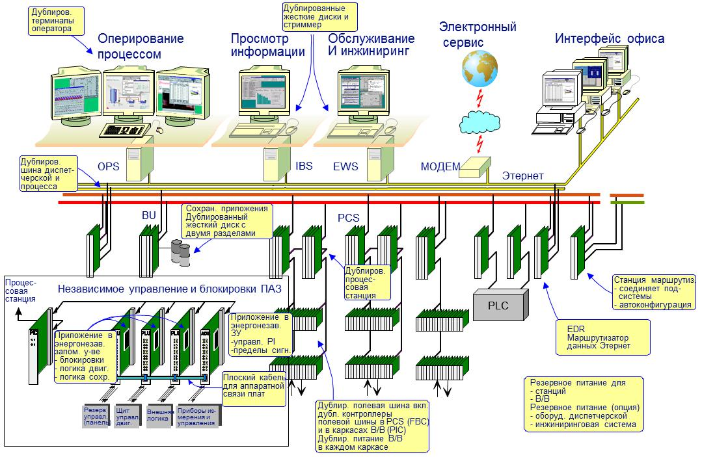
Структура системы metsoDNA

Slide 18
Case Surgutneftegaz (SNG)
1 Identified as potential customer in May 1996
2 General marketing
3 Project selection (3 compressor stations) Q3/98
4 Solution outlines, discussions Q4/98-Q1/99
5 Quotation Q2/99
6 Sales process and negotiation process
7 Tender won and contract signed in July 1999
5,6, 7
x
2
3
4
1
x
1996 1997 1998 1999
After these 3 systems SNG has ordered more than 50 deliveries from Metso Automation

Slide 19
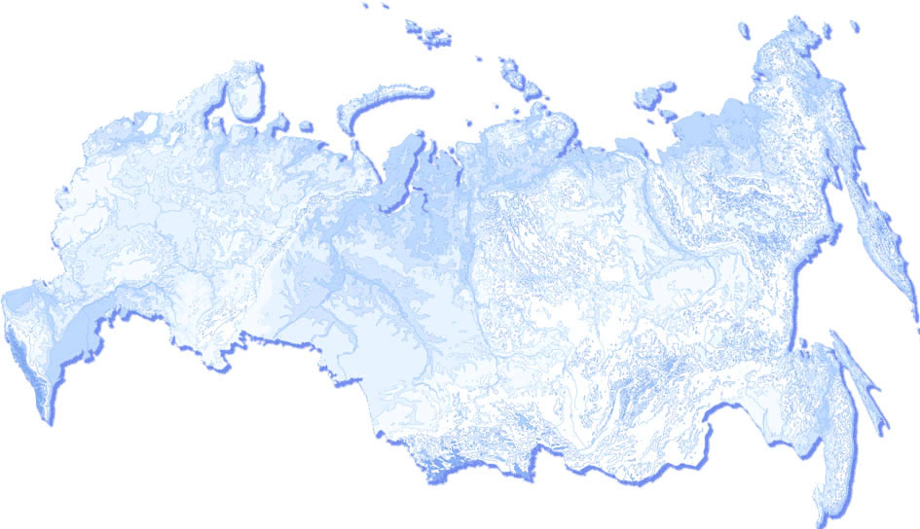
ОАО «Сургутнефтегаз» 2000–2010
Западня Сибирь:
Компрессорная станция 3/1 и 3/2 Лянторского м/р
ГТЭС Тяньского м/р
Компрессорная станция 42 Федоровского м/р
Битумный завод (Установка получения битума)
Компрессорная станция 1 Лянторского м/р
Компрессорная станция 2 Лянторского м/р
Компрессорная станция 7/2 Федоровского м/р
Компрессорная станция 44 Федоровского м/р
ГТЭС Биттемского м/р
ГТЭС Русскинского м/р
ГТЭС на ДНС-1 Лукъявинского м/р
ГТЭС на КНС-11 Лянторского м/р
ГТЭС на КНС-17 Лянторского м/р
Компрессорная станция 41 Федоровского м/р
ГТЭС на ДНС-12 Конитлорского м/р
ГТЭС на ДНС-7 Юкьяунского м/р
ГТЭС на ДНС-3 Мурьяунского м/р
ГТЭС Западно-Камынского м/р
Компрессорная станция 7/1 Федоровского м/р
Компрессорная станция 1 Лянторского м/р – расширение
ГТЭС Тромъеганского м/р
ГТЭС Северо-Лабатьюганского м/р
ГТЭС Западно-Чигоринского м/р
ГТЭС Верхне-Надымского м/р
УКПГ (установка компремирования и подготовки газа) Рогожинского м/р
Компрессорная станция Айпимского м/р
Битумный завод Расширение
Компрессорная станция 7/2 Федоровского м/р 2010
ГТЭС-2 Рогожинского м/р
Компрессорная станция 3/1 и 3/2 Лянторского м/р Расширение
ГТЭС Тяньского м/р Расширение (2011)
ГТЭС-2 Северо-Лабатьюганского м/р (2011)
Якутия:
Компрессорная станция Талаканского м/р
ГТЭС Талаканского м/р
ГТЭС-2 Талаканского м/р
Установка получения битума
Резервуарный парк и станция перекачки топлива
ГТЭС - газо-турбинная элкетростанция
Сургут

Slide 20
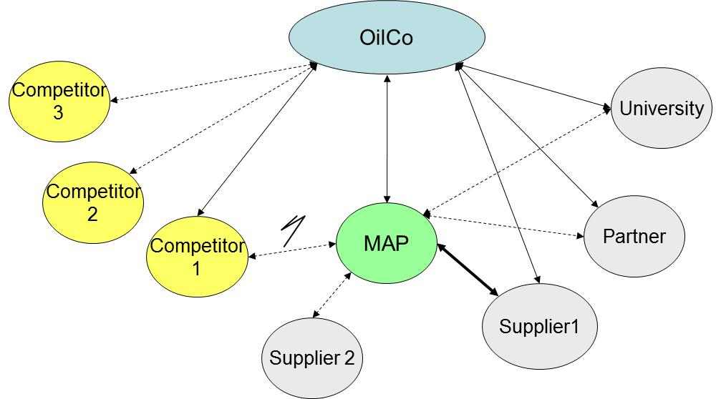
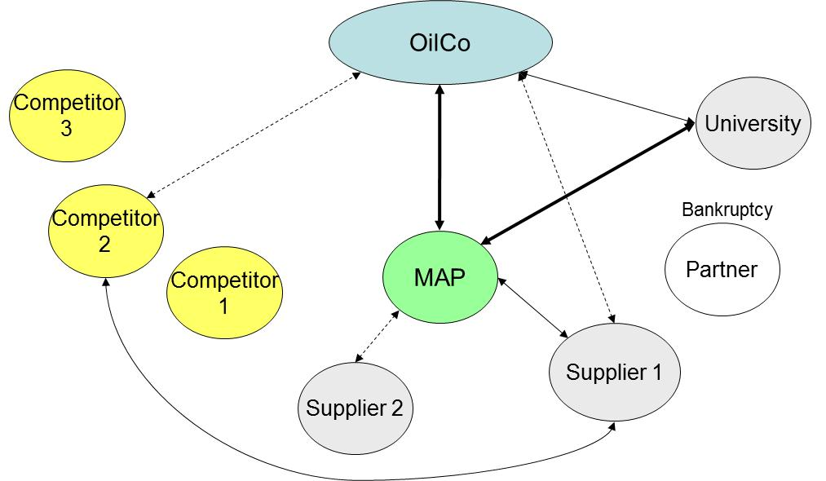
How to use project deliveries to develop stronger market position?
Relational position at end of 1999
Relational position at end of 2005

Slide 21
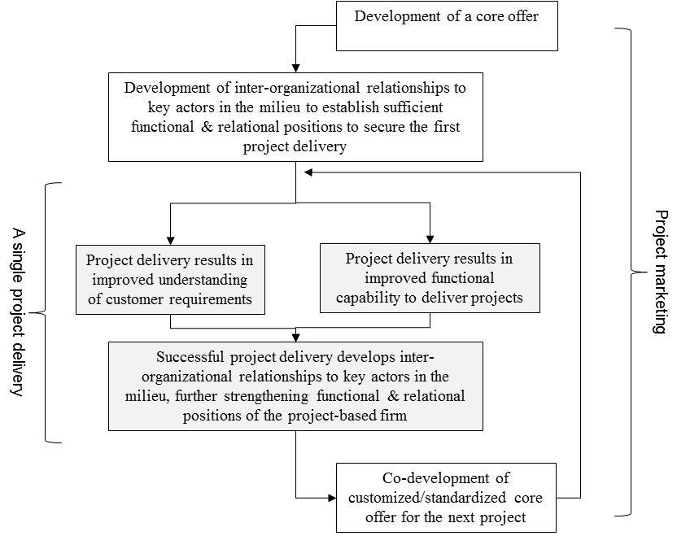
Processual model of project marketing supported by repetitive project deliveries

Slide 22
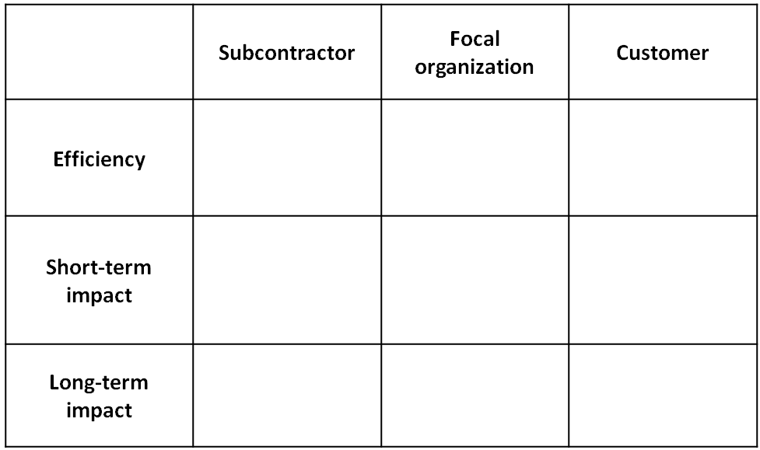
Project success criteria framework (by Artto & Ahola, under development)
The supply/value chain dimension: Your upstream subcontractor, and Your downstream customer
The project at hand: Time/Cost/ Scope
The time dimension: Long-term future considerations
Artto & Ahola, 2013 (Draft)

Slide 23
 | Subcontractor | Focal organization | Customer
Efficiency | Time: The strict schedule requirements were transferred to the subcontractors | Time: The contract included high delay penalties. Therefore, some equipment deliveries were shipped to the site too early without appropriate testing procedures. This caused problems on the site and some of the deliveries were shipped back to the workshop in another country. Finally, the project was executed in time. Cost: Cost overruns occurred due to problems with installation and the returned deliveries. Scope: The delivered system works with full capacity and even above its defined performance requirements | Time: The customer changed the intended time-table many times during the project. Safety: Safety requirements in the target country are strict and therefore the customer hired an external consultant to supervise security measures on the site.
Short-term impact | Learning: One subcontractor delivered a unique subsystem with unique technology in the global market. This project opened new business opportunities for the subcontractor. | Profitability: The project was not a success in terms of profitability, but major losses were avoided Learning: Valuable lessons from managing work safety requirements and procurement. | Meeting the requirements of local and institutional stakeholders: The presence of the local trade-union was strong – they set strict definitions for safety reporting and denied executing two work shifts simultaneously. This caused challenges to the time-table.
Long-term impact | Partnerships: The project introduced a new technological application area for a trusted subcontractor, which will be utilized in future projects | New technology: The project was first of its kind for constructing a system for treating this raw material with this particular process technology; Strategic reference/new market: The system acts as a strategic reference for further project deliveries; A similar system is already being built for another customer Organizational renewal: Experience from delivering novel technologies with fixed price and performance guarantees | Brand and reputation: A safe and working system with high performance is of particular value to the customer.

Slide 24
”Business in Built Environment BBE”: The complex system integrates the business models of multiple stakeholders
Energy – effeciency expert
Energy company
Aalto-university, researchers
Service provider
System
System expert
User - operator
Final customer
Contractor, system builder
Customer
Shareholder
Financier

Slide 25
”Business in Built Environment BBE”: The life cycle of a complex system
System
System
System
Initiation and creation
Development
Operations

Slide 26
Project Business research group (PB)
http://pbgroup.aalto.fi/en/
Aalto University
School of Science
P.O. Box 15500
FI-00076 Aalto
Finland
email: firstname.lastname@aalto.fi
www: http://pbgroup.aalto.fi/en/

Slide 27
Spare slides

Slide 28
The importance of procurement criteria: the customer vs supplier view
The procuring customer’s view | The suppliers’ view
Capability to keep the schedule (6,5) | Price of products, services and solutions (6,5)
Quality of products, services and solutions (6,5) | Capability to keep the schedule (5,0)
Price of products, services and solutions (6,4) | Project management capability (5,0)
Project management capability (6,3) | Experiences from previous projects (4,9)
Capability to manage own sub-contractors /integration capability (6,3) | Available capacity (4,7)
Available capacity (6,0) | Capability to manage own subcontractors /integration capability (4,4)
Economic wealthiness of the contractor (5,6) | Quality of products, services and solutions (4,2)
Experiences from previous projects (5,5) | Economic wealthiness of the contractor (3,6)
1.
1.
2.
2.
3.
3.
4.
5.
6.
9.
5.
12.
9.
15.
7.
14.
Ahola & Westerholm, 2008

Slide 29
A simplified/adjusted business model characterization
Network of partners and/or suppliers
Relationship
Core capabilities
Offering and/or value proposition
Customer
Profit-making logic
By Karlos Artto, 2013

Slide 30
Project success criteria framework (by Artto & Ahola, under development)
Artto & Ahola, 2013 (Draft)

Slide 31
Project success criteria framework in a project supply chain of multiple firms
(by Artto & Ahola, under development)
X
Customer
(e.g. owner-operator)
X
Contractor
(or systems integrator)
The mark
X
indicates the
anticipated initial locus of
success criteria
X
Subcontractor
(or supplier)
Artto & Ahola, 2013 (Draft)

Slide 32
Challenges with risk management in firms
Risk identification and analysis is conducted only once properly
Risk management activities are done only because company rules say so
The applications of the generic risk management process are exhaustive
Risk check lists kill creativity
Content of risk check lists
IT-systems or tools are not too helpful, as the actual effect comes from interaction among individuals
Lack of facilitators that would serve as talk show hosts
Risk management gets isolated to become only the responsibility of the project manager or a risk analyst
Learning concerning risks occurs through on ex-post analyses and is based on documenting risks

Slide 33
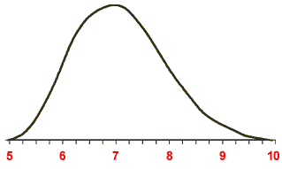
Disintegration
It tool 1
It tool 2
Identification
Estimation
1
Response planning
RM
2
PROJECT
PM
Executive
Project manager
Service manager
Sales manager
5
3
4
”Risks must be managed, so just do it”.
Notes:
33

Slide 34
”Project business” definition
“Project business is the part of business that relates directly or indirectly to projects, with the purpose of achieving objectives of a firm or several firms.”
( from: Artto & Wikström, 2005, IJPM article on: “What is project business?” )

Slide 35
Project business framework: literature sources that elaborate the framework
Article:
Artto K., Kujala J. (2008). Project business as a research field, International Journal of Managing Projects in Business, 1(4):469-497
Book chapter:
Artto K., Davies A., Kujala J., Prencipe A., (2010). The project business: analytical framework and research opportunities. Chapter 5 (pages 133-153) in: Morris P. W. G., Pinto J., Söderlund J. (eds.), Oxford Handbook of Project Management, Oxford University Press, Oxford, UK

Slide 36
Project business framework: four distinctive management areas
One firm
Many firms
1. Management of a project
3. Management of a project network
One project
2. Management of a project-based firm
4. Management of a business network
Many projects
Artto & Kujala (2008)
Artto, Davies, Kujala, & Prencipe, 2011
See a brief explanation of this framework from the “Foreword to the 1st English language edition (2011) of ‘Project business’ book, downloadable from http://pbgroup.aalto.fi/en/

Slide 37
Project business framework: four distinctive management areas and their interfaces
One firm
Many firms
1. Management of a project
3. Management of a project network
One project
Interface 1-3
Interface 1-2
Interface 3-4
2. Management of a project-based firm
4. Management of a business network
Many projects
Interface 2-4
Artto & Kujala (2008)

Slide 38
Characterizing the project business research field: distinctive contents of the four major areas
1. Management of a project
3. Management of a project network
Management object: A project.
Measure of success: Meeting of predefined project goals.
Significant contingency factors: Project uniqueness, novelty, technology, complexity, pace.
Management object: A project as a multi-firm network.
Measure of success: Meeting of project’s goals with simultaneous achievement of expectations and business objectives of the firms participating in the project.
Significant contingency factors: Participating firms, asymmetry of their objectives, interests and identities.
2. Management of a project-based firm
4. Management of a business network
Management object: A firm.
Measure of success: Achievement of short-term and long-term business objectives of the firm.
Significant contingency factors: Discontinuity, interdependence between projects, market and technological uncertainty.
Management object: A network of firms and their relationships.
Measure of success: Competitiveness and capability of individual firms and networks to create and implement new projects.
Significant contingency factors: Norms and culture, institutional issues, governance schemes, relationship between firms, role stability.
Artto & Kujala (2008)

Slide 39
Project business framework with specific research areas and themes
1. Management of a project
3. Management of a project network
management of risk and uncertainty
contingency theory view and systems view on projects
project strategy
inside-out management of project’s interface to its context
large projects research
project as network of firms
project as multi-organization enterprise
dynamism in project network
learning within the project network
stakeholder management
systems integration
project delivery chain and supply chain management
within a project
governance in project network
Interface 1-3
Interface 1-2
Interface 3-4
2. Management of a project-based firm
4. Management of a business network
theory of project-based firm and the firm’s business model
learning, capabilities and competencies
selling and delivering projects
procurement and supplier network management
the role and management of products in the business of a
project-based firm
the role of services in the business of a project-based firm
portfolio and program management
resource management in a project-based firm
interplay between temporary project networks and
the permanent business network
measurement of performance in business network
analysis of networked business environment and
design of the firm’s strategy
ever-changing roles of the network’s players
multiple conflicting interests and fragmented entities
even within one single firm
embedded innovation in business activities in the network
moving base in the value stream
Interface 2-4
Artto & Kujala (2008)

Slide 40
The main managerial challenges in the four areas of the project business
1. Management of a project
3. Management of a project network
Unit of analysis: A project as a business entity.
Managerial challenge: … to manage a single project effectively in its environment by taking into account that the project is a purposeful business entity and the management of its inherent business content can be compared to the management of a firm’s business.
Unit of analysis: A project as a multi-firm network.
Managerial challenge: … to manage a project as a multi-firm enterprise through managing multiple firms participating to the project, by creating a contractual or an organizational arrangement that enhances goal alignment and coordination across multiple firms.
2. Management of a project-based firm
4. Management of a business network
Unit of analysis: A firm or a portfolio of projects.
Managerial challenge: … to manage a firm and its multiple projects as a whole, by ensuring that projects support the strategy and business objectives of the firm, by simultaneously allocating the firm’s scarce resources to projects.
Unit of analysis: A network of firms and their relationships.
Managerial challenge: … to manage a network of actors and their relationships in an open and competitive business marketplace where the firms may or may not engage in joint projects with other firms. From a single firm’s or project’s viewpoint, maintaining efficiency and innovativeness in the network is central, and is affected by how the firms and projects decide to position themselves in the value network of all business players and non-business actors.
Artto, Davies, Kujala, & Prencipe (2010)

Slide 41
The free-of-charge ”Project business” book -> download
The ” book can be downloaded free-of-charge from the Project Business research group’s webpage:
http://pbgroup.aalto.fi/en/the_book_and_the_glossary/
The bibliographic data of the book:
in English:
”Artto K., Martinsuo M., Kujala J., 2011. Project business. Helsinki, Finland, http://pbgroup.aalto.fi/en/ , (ISBN 978-952-92-8535-8) “
in Finnish:
”Artto K., Martinsuo M., Kujala J., 2006. Projektiliiketoiminta. WSOY, Helsinki, http://pbgroup.aalto.fi/en/ , (ISBN 978-952-92-8534-1)“

